Slide 1

Sorting Algorithms in Java
Saif Mostafa, Akram Aljarallah

Slide 2
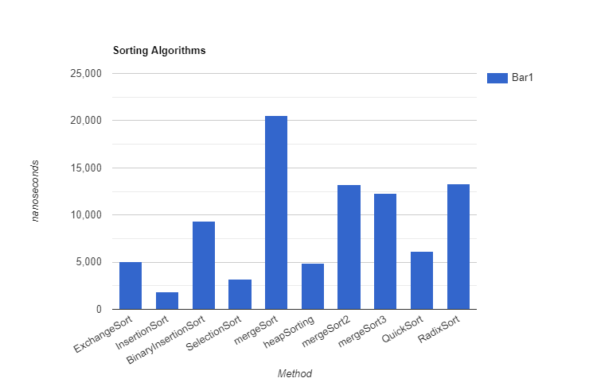
Runtimes:
SIZE: 10
In arrays of small size such as 10, we can see merge sort with its different implementation has the highest runtime along with Radix sort.
Insertion sort, Selection sort, and Heap sort are the most efficient sorting algorithms for array with small size.

Slide 3
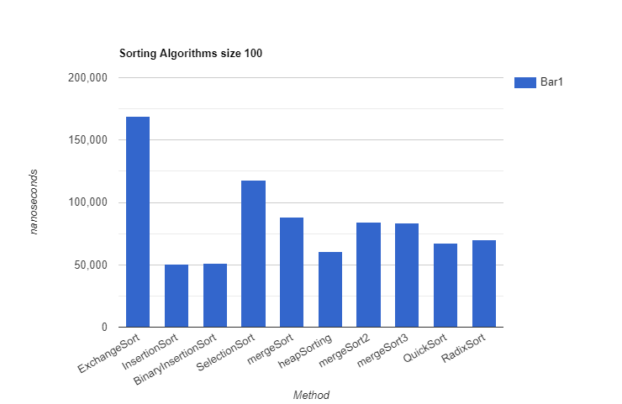
Runtimes:
SIZE: 100
As we go bigger in size (100,) Merge sort becomes more efficient unlike Exchange sort which its runtime increased significantly.
As we go bigger in size, Insertion sort and Heap sort are still very efficient algorithms. BinaryInsertion sort became very efficient.

Slide 4
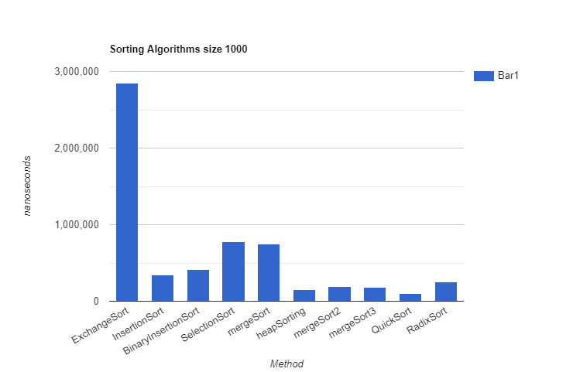
Runtimes:
SIZE 1000
Exchange sort is still the least efficient algorithm as we go bigger in size.
Insertion sort became less efficient when we increased the size of the array to 1000 compared to other algorithms such as: Quick sort, Heap sort, and Radix sort.

Slide 5
Conclusion:
Heap sort is very efficient no matter how big the array is.
Exchange sort is the least efficient if we are working with an array size bigger than 15.
BinaryInsertion sort became the Most efficient as we go higher in the size.

Slide 6




